Slide 1

ANALYZING ROAD SAFETY & TRAFFIC DEMOGRAPHICS IN THE UK
Richard abraham

Slide 2


Background:
World Health Organization (WHO) reported that more than 1.25 million people die each year while 50 million are injured as a result of road accidents worldwide
Road accidents are the 10th leading cause of death globally
On current trends, road traffic accidents are to become the 7th leading cause of death by 2030 making it a major public health concern
Between the years 2005 and 2016, there were roughly 2 million road accidents reported in the United Kingdom (UK) alone of which 16,000 were fatal

Slide 3


Business Objective:
Used the UK Traffic Accidents dataset obtained from Kaggle’s data repository to:
Identify factors responsible for most of the reported accidents
Build a predictive model capable of accurately determining the severity of an accident based on a set of input factors
Provide recommendations to UK’s department of Transport - to improve road safety policies and prevent accident recurrences where possible

Slide 4
Data Description:
Accident_Information.csv
2 million rows x 33 columns
Details pertaining to each reported accident
Vehicle_Information.csv
2.1 million rows x 23 columns
Detailed information about vehicles involved
Attributes comprise of both numerical and categorical features
Target variable Accident Severity (3 Classes – SLIGHT, SERIOUS & FATAL) which is measured as a combination of both physical injuries and property damage
Dataset consists of missing (NULLs)/erroneous values
Merged data set contains an imbalanced target class for accident severity

Slide 5
Analytic Goals:
Carry out a retrospective study of the historical dataset (2005-2016) and perform descriptive analysis to reveal interesting insights
Identify factors commonly responsible for road accidents through Feature Engineering techniques
Fine-tune model to enhance its predictive power while also focusing efforts to optimize resource utilization and model run-times
Main Outcome Variable:
Accident Severity – # Casualties + # Vehicles involved

Slide 6

Data Cleansing:
Columns with 40% or greater missing values (NULLs) were dropped
Rows with erroneous values such as ‘data out of range/Unknown’ or driver’s age <= 10 were dropped
Columns with high correlation to other independent columns were dropped to avoid multi-collinearity
Data transformations were carried out and columns were inspected to check for levels of variance
Reduced target class from a multi-class classification to a binary classification problem to handle an imbalanced dataset and simplify analysis

Slide 7
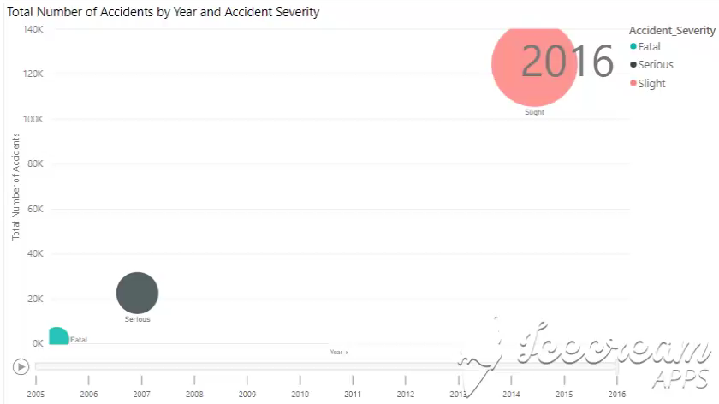
Exploratory Data Analysis:

Slide 8
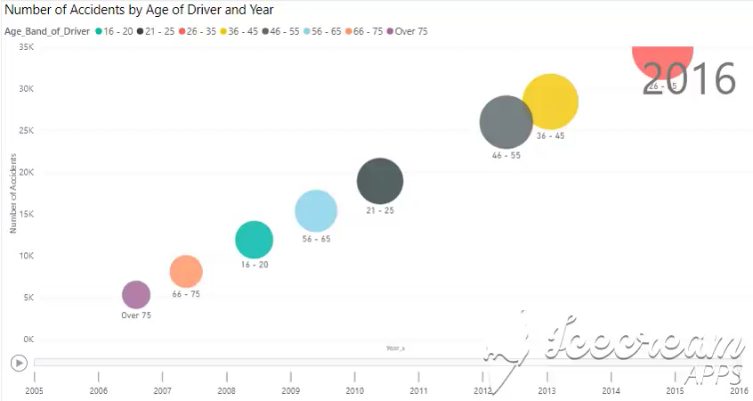
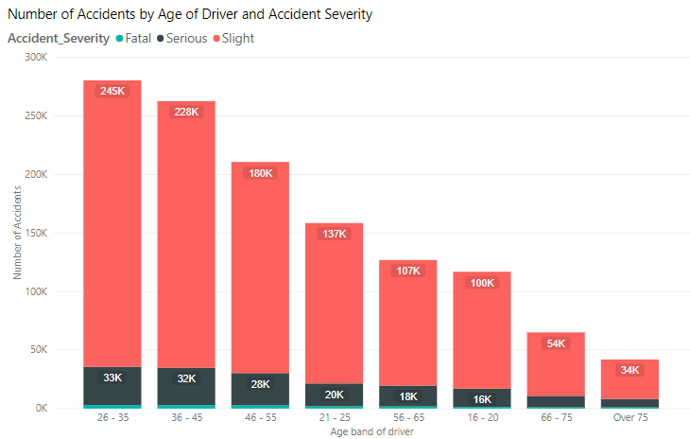
Exploratory Data Analysis:

Slide 9
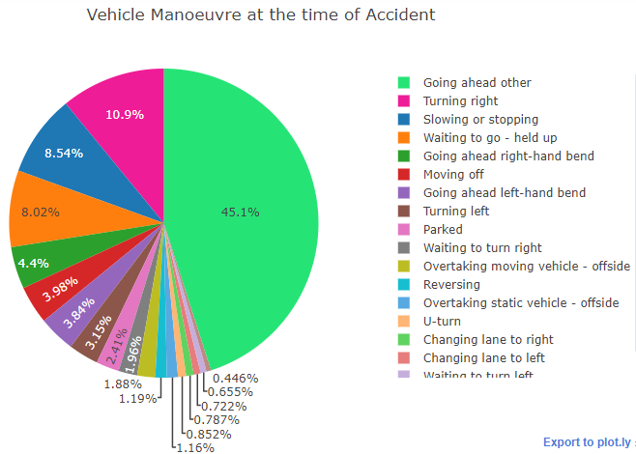
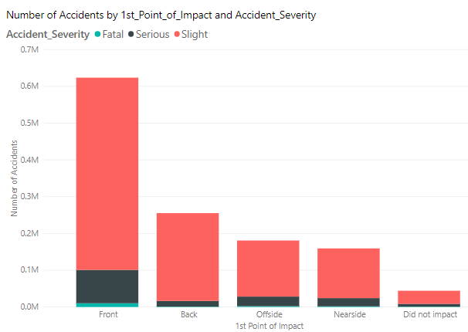
Exploratory Data Analysis:

Slide 10
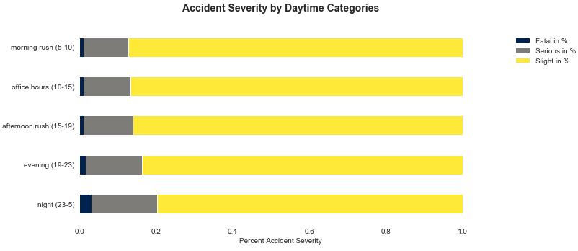
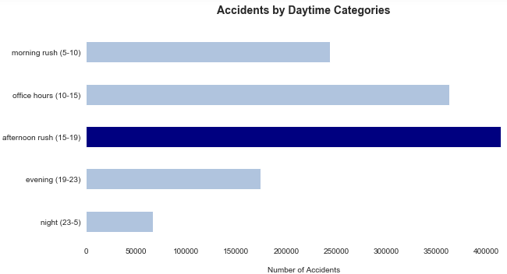
Exploratory Data Analysis:
Majority of fatal accidents took place at night

Slide 11
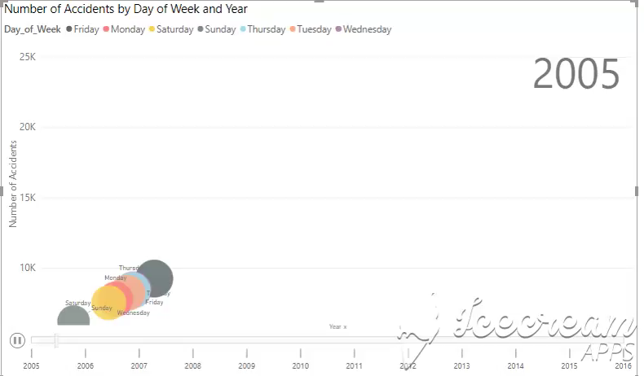
Exploratory Data Analysis:

Slide 12
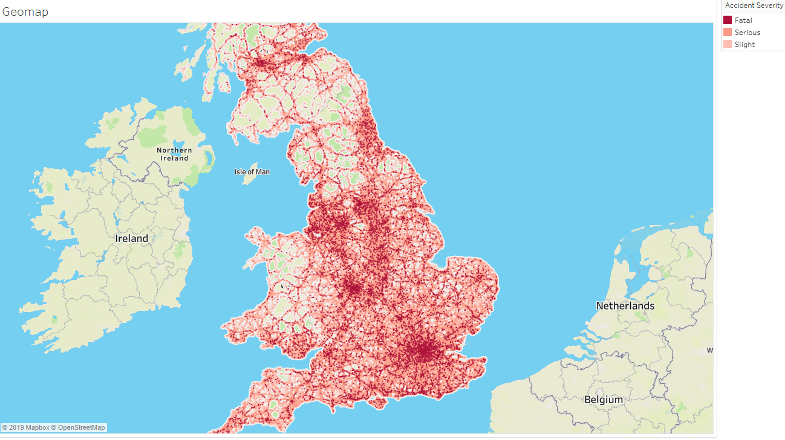
Exploratory Data Analysis:
RTA Density by Location:
Birmingham
London
Leeds
Newcastle

Slide 13
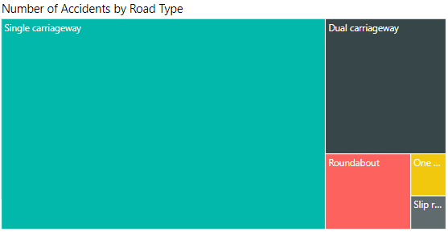
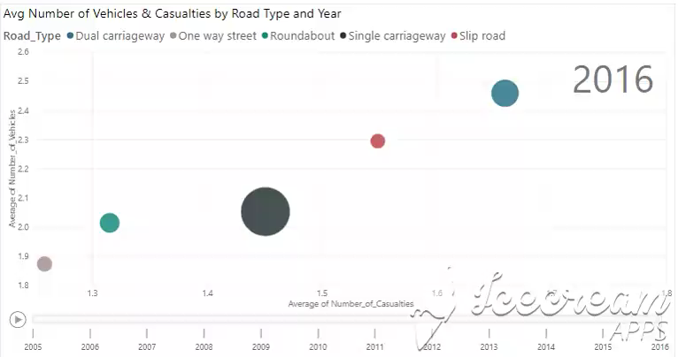
Exploratory Data Analysis:
Avg. number of vehicles and casualties are highest for dual carriageways

Slide 14

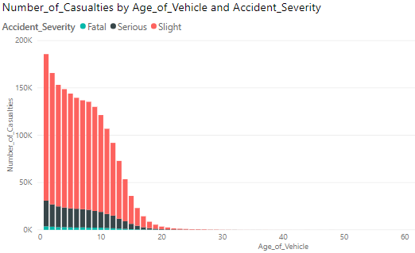


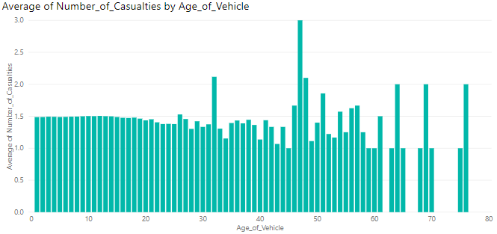

Exploratory Data Analysis
Older Vehicles

Slide 15
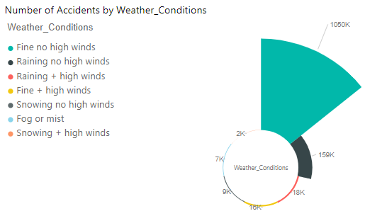
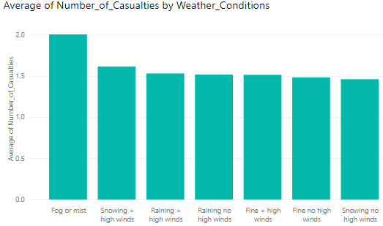
Exploratory Data Analysis:
Avg. number of casualties are highest on Foggy (mist) days

Slide 16
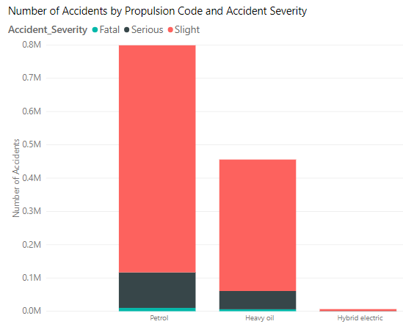
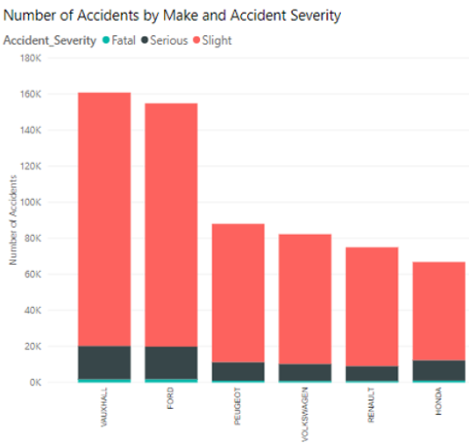
Exploratory Data Analysis:

Slide 17
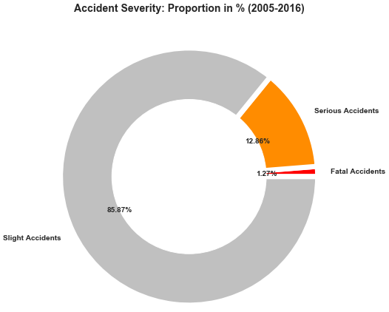
Overview of Techniques Used:
Imbalanced Target Class:
SMOTE, ClusterCentroids, TomekLinks
Feature Engineering:
PCA, RFECV, Variance Threshold, RandomForest Feature Import.
Supervised Classification Algorithms:
Gaussian Naïve Bayes, Logistic Regression, Tree-Based Algorithms – Random Forest / Gradient Boost Classifiers, KNN, SVM
Performance Metrics:
F1-Score, Precision, Recall, ROC/AUC curves, Accuracy Score, Cohens Kappa, Mathews Correlation Coefficient (MCC)

Slide 18
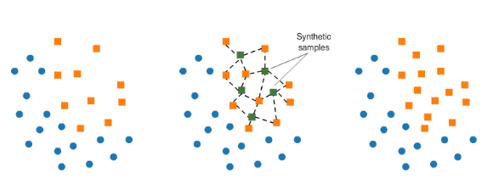
Synthetic Minority Oversampling Technique (SMOTE)
Consists of synthesizing elements for the minority class, based on those that already exist
Randomly picks a point from the minority class (Fatal) and computes the k-nearest neighbors for this point
Synthetic points are added between chosen points and its neighbors

Slide 19
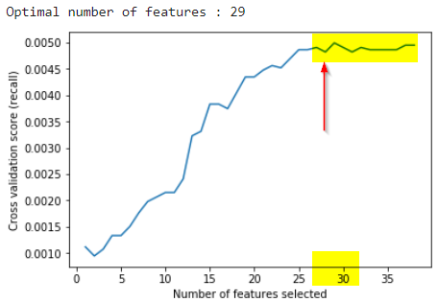
Recursive Feature Elimination with Cross Validation – Logistic Regression
Top 10 Features:
Number of Vehicles Involved/ Casualties
Engine Capacity CC
Speed Limit
Age band of driver
Day of the week – FRIDAY
Daytime afternoon rush (15-19)
Light Conditions – DARK/NIGHT
Location (Latitude/Longitude)
Weather Conditions – Fine with NO High Winds
Age of the Vehicle

Slide 20
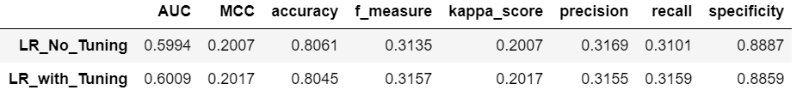
Logistic Regression:
0.685
Hyper-parameter Tuning:
'C': 1.e-04, 1.e-02, 1.e+00, 1.e+02
Cv = 3, 5

Slide 21
Gaussian Naïve Bayes:
0.683
Best Recall So Far

Slide 22
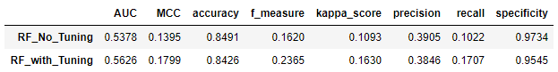
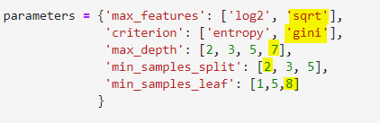
Tree-Based Algorithm: RandomForest
Model Performances:
Hyper-parameter Tuning:

Slide 23
Tree-Based Algorithm: GradientBoost
Much lower than previous models

Slide 24
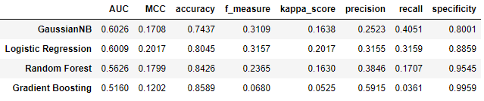


Model Comparison:
0.683
0.685

Slide 25

Implications:
Decrease emergency response times during afternoon rush-hours (15-19) especially on Fridays
Allocate resources to investigate high density traffic points and identify new infrastructure needs to divert traffic from dual-carriage ways
Explore conditions of vehicles and casualties such as vehicle type, age of vehicles registered, pedestrian movements, etc. for policy makers
Enforce strict regulations for speed limits in accident prone areas
Adopt comprehensive distracted driving laws that increase penalties for drivers who commit traffic violations like aggressive overtaking
Use the predictive model to test the effects of implementing regulations to reduce the rate of severe accidents to an acceptable threshold

Slide 26
Challenges/Recommendations:
Dataset was highly imbalanced making it difficult to build a model precise enough to accurately predict accident severity
Computing constraints - had to randomly truncate the dataset down to a manageable size and avoid running a few models to completion (SVM, KNN)
All data dealt with were records of accidents that have already occurred
FUTURE DATA COLLECTION:
Incorporate data for conditions resulting in NO accidents to help identify most ideal road conditions
Incorporate accidents data for fully electric vehicles to attain a more wholesome view

